Slide 1
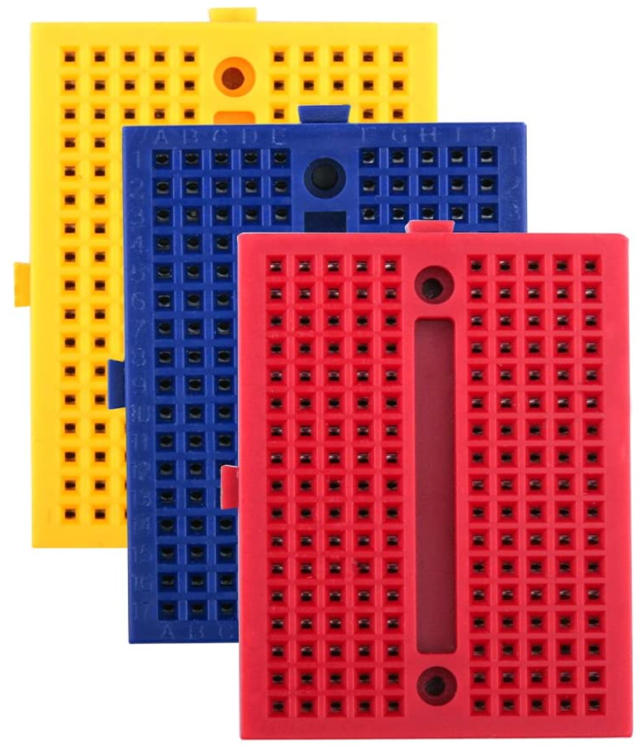
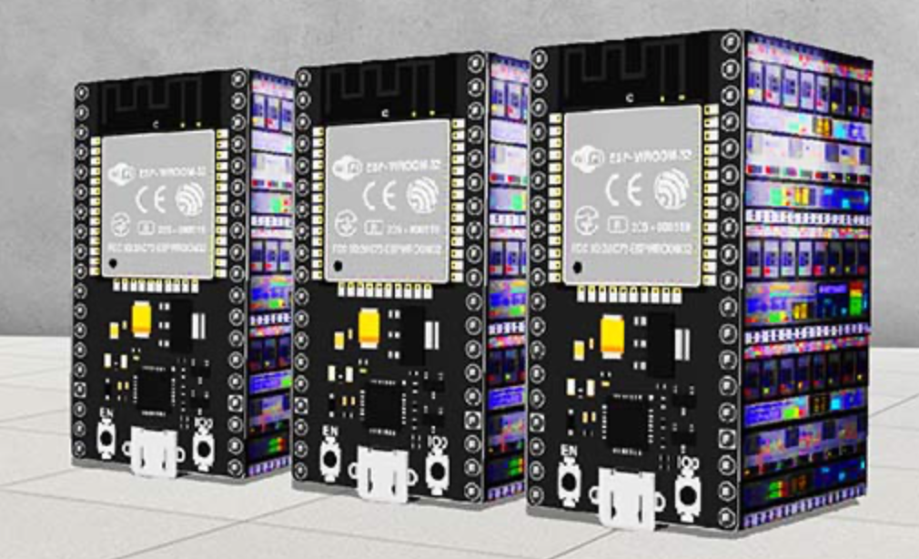
Create a Web Server with ESP32 and Arduino IDE
IoT with ESP32
MODULE 2b
https://electropeak.com/learn/create-a-web-server-w-esp32/
| IoT with ESP32 | Rev01-JAN2021 |

Slide 2
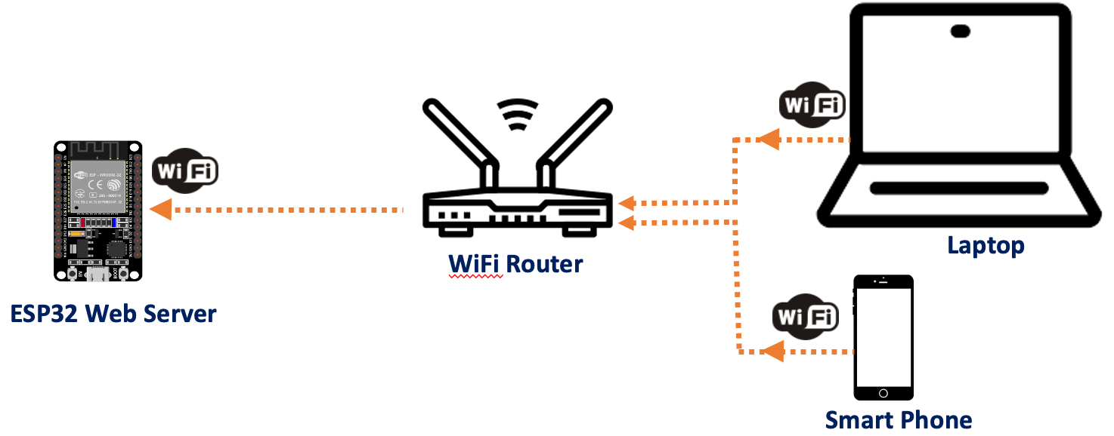
2b. Create a Web Server with ESP32 and Arduino IDE
Project Overview
Before we start, it is important to outline what our web server will do:
→ Setting up ESP32 as web server (Station/STA).
→ In this mode, ESP32 gets IP from wireless router to which it is connected.
→ Can locally access the ESP32 web server by typing either IP address or esp32.local at browser.
→ Access ESP32 from various devices.
Rev01 JAN2021

Slide 3
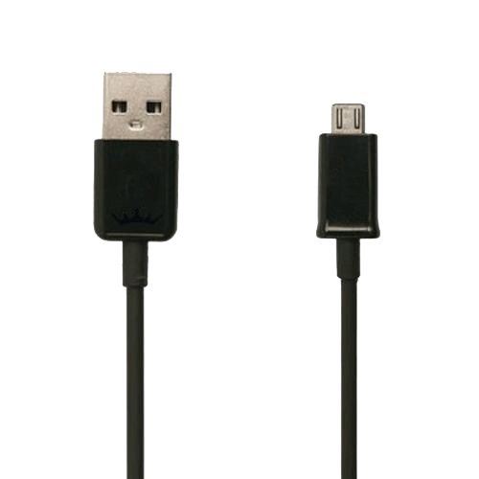
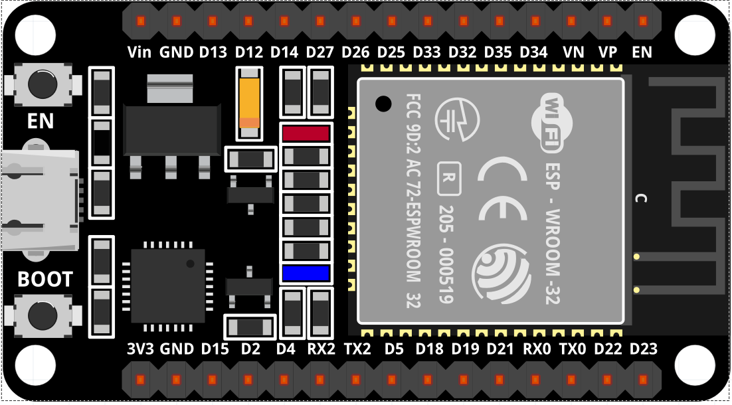
2b. Create a Web Server with ESP32 and Arduino IDE
Components
→ 1 x ESP-32 Wifi+Bluetooth 2-In-1 Development Board for Arduino (30 pin) + Cable.
→ 2 x Mini Breadboard.
Rev01 JAN2021

Slide 4

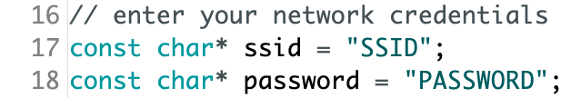
2b. Create a Web Server with ESP32 and Arduino IDE
Working File
→ Download the file working file from http://bit.ly/3aB3WBL by click at ..
→ Unzip and find sketch-iii_esp32-webserver.ino. Double click to open the file with Arduino IDE.
→ Click OK when Arduino pop-up window appears. This action will create a folder that carry same name with sketch (sketchiii_esp32-webserver.ino) and move the sketch into it. Click Cancel will not open the sketch at all.
→ Before upload the sketch to the board, modify the following two variables and suit with your network credentials. This will allow ESP32 establish connection with your network.
→ Upload the sketch to your ESP32 board. Ensure that you have selected the right board
and set the current port. Don’t forget to press BOOT button. Refer to Troubleshoot section if you have problem.
Rev01 JAN2021

Slide 5

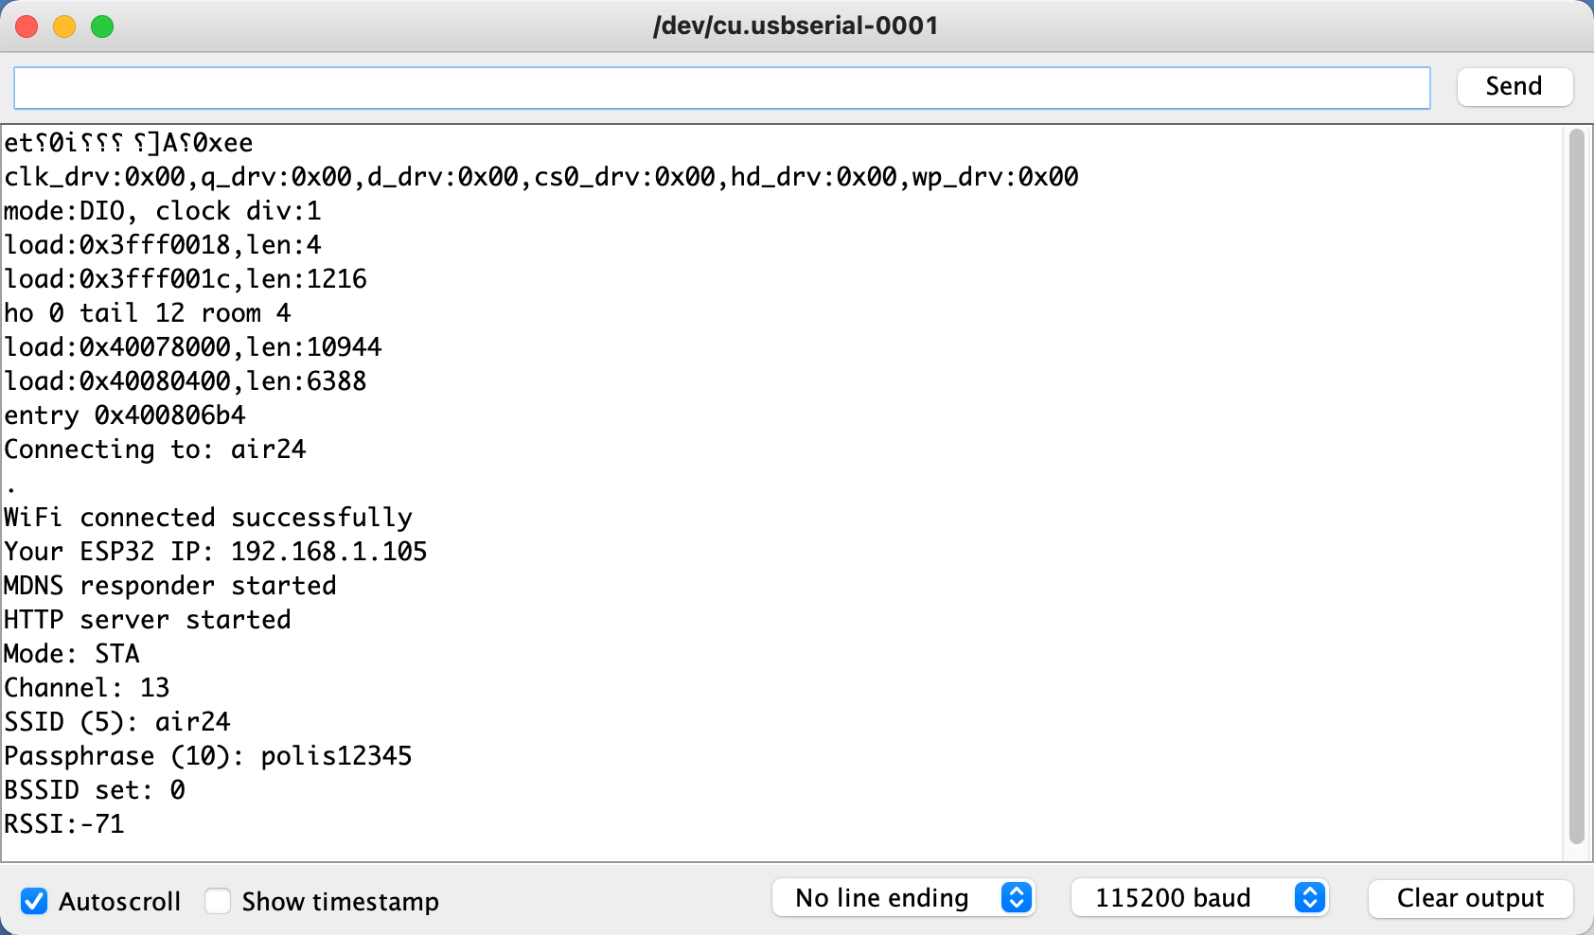
2b. Create a Web Server with ESP32 and Arduino IDE
The Output
→ Click the Serial Monitor icon to display the serial data receive & transmit by ESP32.
Connecting to wireless router SSID named air24
Attempt to connect to air24
Successfully connected to air24 wireless router
IP address released by air24
http://esp32.local
Web server service started
Web server service started
WiFi diagnostic information
MAC address of the wireless router
Received Signal Strength Indicator of AP, -50 dBm is excellent while 100dBm means no signal
Set baud rate to 115200
Rev01 JAN2021

Slide 6
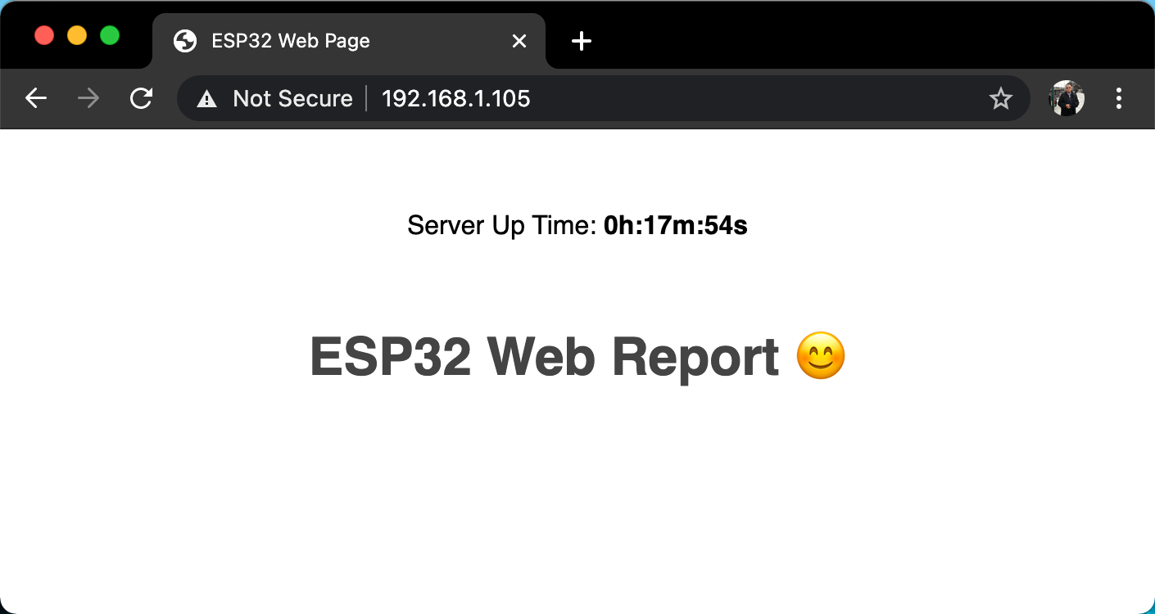
2b. Create a Web Server with ESP32 and Arduino IDE
The Output
→ Open a browser and type the ESP32 IP address, 192.168.1.105
# Compare the output with the sketch & indicate which line produces them.
# What is the refresh rate? Trace the syntax.
Rev01 JAN2021

Slide 7

2b. Create a Web Server with ESP32 and Arduino IDE
The Output
→ You can also type esp32.local instead of 192.168.1.105
# Compare the output with the sketch & indicate which line produce this.
Rev01 JAN2021

Slide 8
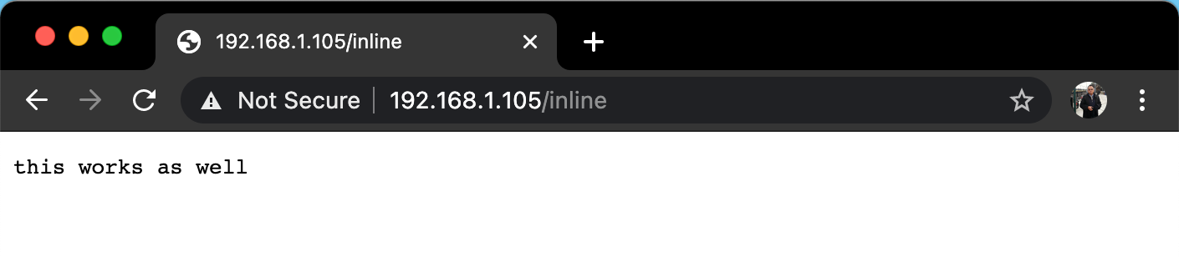
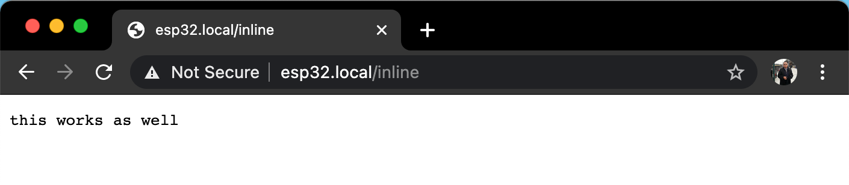
2b. Create a Web Server with ESP32 and Arduino IDE
The Output
→ Add inline at the end of 192.168.1.100/ and esp32.local/.
# Trace which syntax produce this output.
Rev01 JAN2021

Slide 9
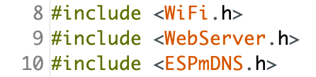
2b. Create a Web Server with ESP32 and Arduino IDE
Code Explanation
→ Filename: sketch-iii_esp32-webserver.ino
→ This sketch consists of 4 functions:
void setup( ), void loop( ), String SendHTML( ), void handle_root( )
→ Start the sketch with the library includes:
Wifi.h is to allow ESP32 to join WiFi network
WebServer.h is to enable HTTP web server service to run on EPS32
ESPmDNS.h is to resolves hostname to ESP32 IP address
→ Add the network credential to which wireless router the ESP32 will be connected:
Rev01 JAN2021

Slide 10
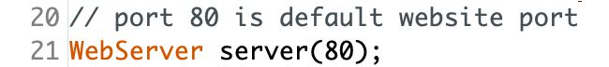
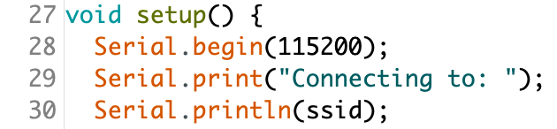
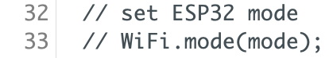
2b. Create a Web Server with ESP32 and Arduino IDE
Code Explanation
→ Create a Web Server object that listens for HTTP request in port 80.
Line #27 - #78 took place in void setup( ) function
→ Opens serial port & set data rate at 115200. This will allow us to see text & values (send & receive) activities in ESP32 on your computer/laptop thru Serial Monitor by using Serial.print( ) command. The 9,600 baud rate is approximately 1,000 characters per second.
→ Set ESP32 as web server mode. Other modes available: WIFI_OFF (turn off WiFi), WIFI_STA (Station mode), WIFI_AP (Access Point mode), WIFI_AP_STA (both Station and Access Point mode). In WIFI_STA mode, the ESP32 will gets the IP address from wireless router that connects to it.
Rev01 JAN2021

Slide 11
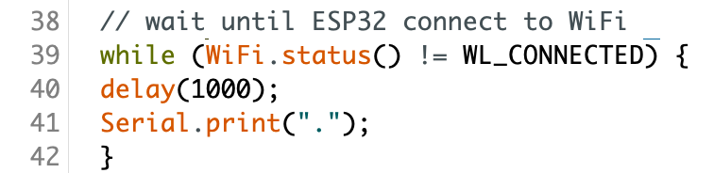
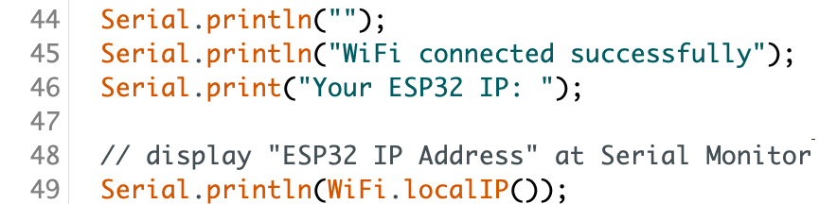
2b. Create a Web Server with ESP32 and Arduino IDE
Code Explanation
→ The following function is to make ESP32 a WiFi client that connect to a network with provided ssid and password. If we use this function can replace WiFi.mode(WIFI_STA) function.
→ Print dotted lines until ESP32 connected to wireless router.
→ The following information will be display at Serial Monitor including EPS32 IP address.
Rev01 JAN2021

Slide 12
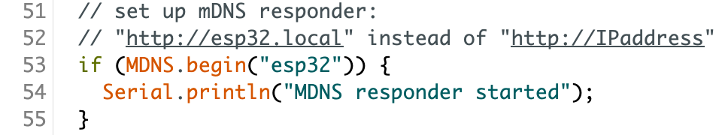
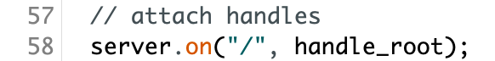
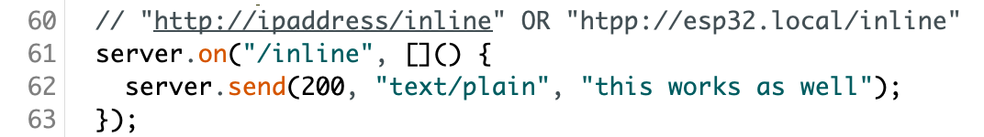
2b. Create a Web Server with ESP32 and Arduino IDE
Code Explanation
→ ESP32 will multicast a message including its IP address to members of network and they will update their mDNS cahces. Domain System resolves host name to IP address. To access, just use http://esp32.local instead of http://IPaddress.
→ server.on will specify what ESP32 to do upon client request. When requested, handle_root function is called and display the web page.
→ When client request IPaddress/inline or esp32/inline, a plain text website with the ‘this works as well’ will appears.
Rev01 JAN2021

Slide 13
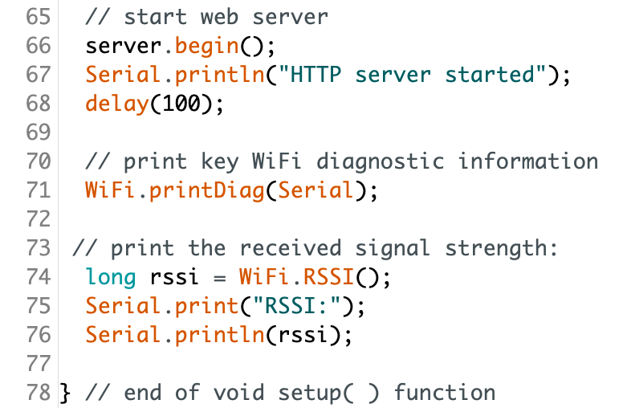
2b. Create a Web Server with ESP32 and Arduino IDE
Code Explanation
→ Start listening for incoming connections. ESP32 will display WiFi diagnostic information and received signal strength over Serial Monitor.
Rev01 JAN2021

Slide 14
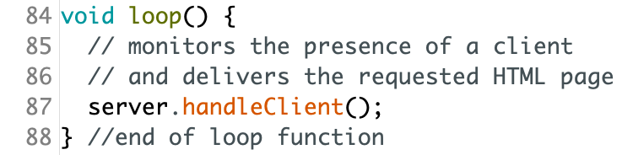
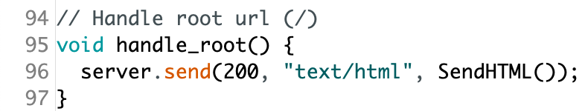
2b. Create a Web Server with ESP32 and Arduino IDE
Code Explanation
→ In the loop function, ESP32 will check if any client has sent an HTTP request or not. If client request is available, the ESP32 will deliver the requested HTML page by calling the handle_root( ) function.
→ The handle_root( ) function gets called when the web page URL is set to root like esp32.local. The function simply call SendHTML( ) to display at browser.
Rev01 JAN2021

Slide 15
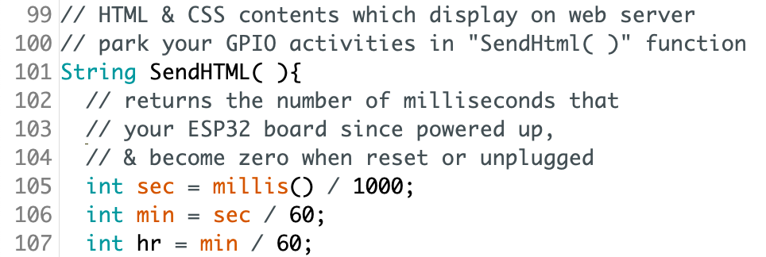
2b. Create a Web Server with ESP32 and Arduino IDE
Code Explanation
Line #101 to #132 took place in String SendHTML ( ) function
→ You may add lines that reads sensor values, control motors, servos, leds, timer etc within SendHTML( ) function which bind with HTML syntax. We are using millis( ) function as time measurement within the sketch. The time itself will become zero whenever power supply is removed or reset the board.
Rev01 JAN2021

Slide 16
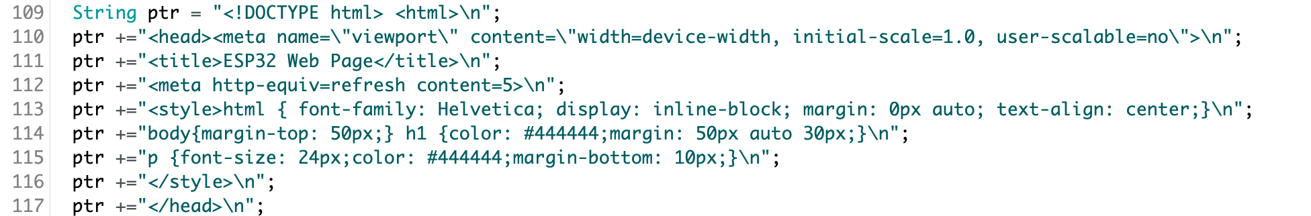
2b. Create a Web Server with ESP32 and Arduino IDE
Code Explanation
→ Basically, the HTML used in ESP32 is similar with other HTML for web, except need to add certain lines in order to allow the board ability to translate the language that its understand. FYI, the server will refresh every 5 second – refer to Line #112.
Rev01 JAN2021

Slide 17
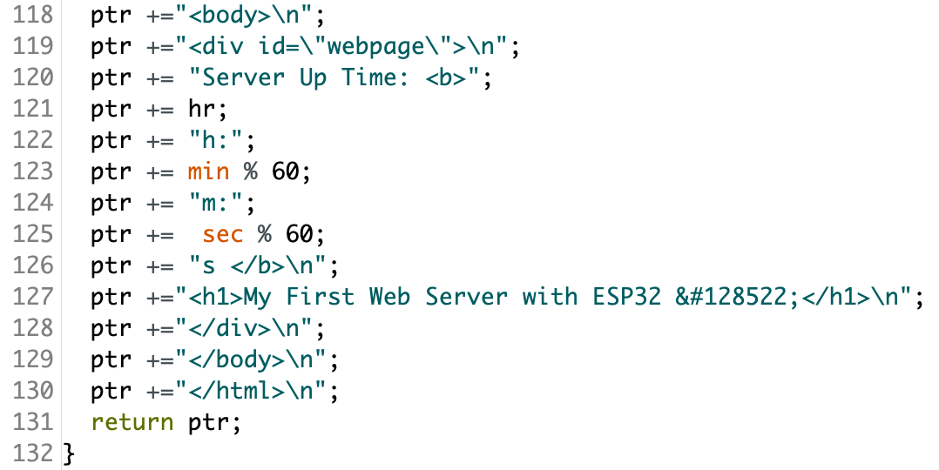
Configuring ESP32 as Stand-Alone Web Server using Arduino IDE
Code Explanation
→ Go through every line & notice that the syntax without double quote “foo” are the C language while within “foo” are HTML syntax. Different application will have different sensors, motors & web layout.
Rev01 JAN2021

Slide 18
2b. Create a Web Server with ESP32 and Arduino IDE
QUESTIONS?
Questions?
Rev01 JAN2021

Slide 19
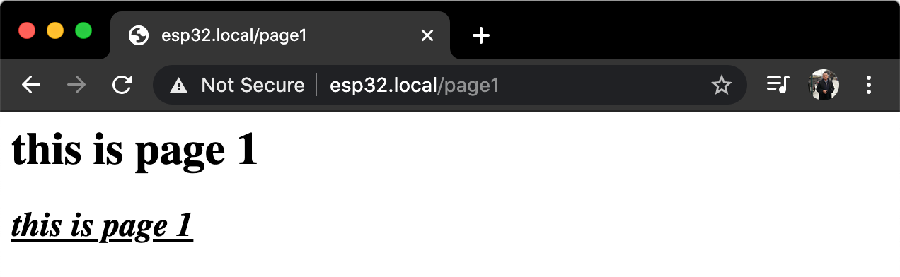
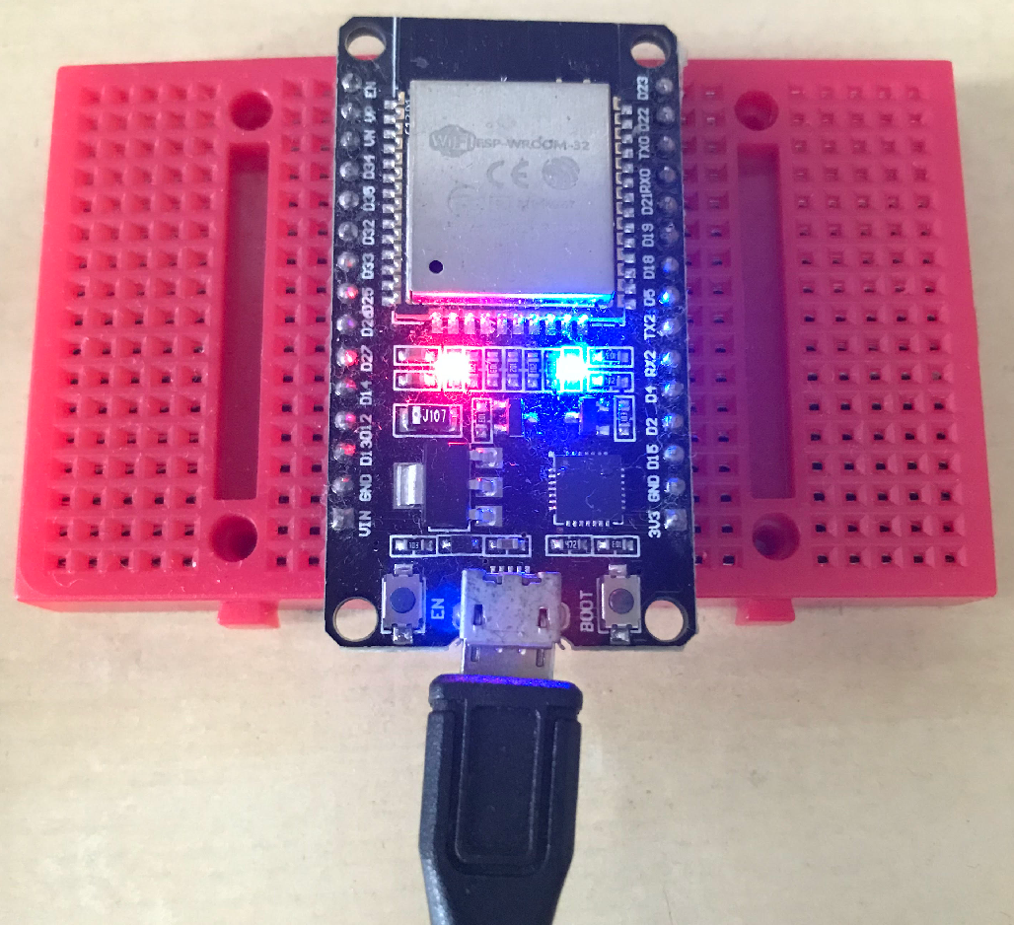
2b. Create a Web Server with ESP32 and Arduino IDE
EXERCISE
Add a few lines in the sketch & produce output as follows.
[10 minutes activity]
Turn on built-in led when client browsing the esp32.local/page1 website.
Rev01 JAN2021

Slide 20
2b. Create a Web Server with ESP32 and Arduino IDE
ANSWER
…
server.on("/page1", [ ]( ) {
digitalWrite(led,1);
server.send(200, "text/html",
"<h1>this is page 1</h1>"
"<h2><i><u>this is page 1</u></i></h2>"
)
...
Rev01 JAN2021

Slide 21
i. Getting Started with ESP32 & DHT11
TROUBLESHOOT GUIDE
Failed to upload the sketch to ESP32? Follow these steps:
→ Press REBOOT button until the IDE approaches Connecting… segment;
→ OR, check whether you have chosen the correct Board and set the correct PORT;
* Choose the right board by going to Tools > Boards > ESP32 Dev Module
* Select the correct port at Tools > Port > choose the appropriate serial port
→ OR, unplugging the board from USB and plugging back;
→ OR, Verify to confirm that your sketch is error free;
→ OR, Swap to other PC / Laptops;
→ OR, Use different board;
→ You are using micro-USB power cable instead of power & data cable.
Rev01 JAN2021

